Slide 1
Today's agenda
Perceptron
Linear classifier
Loss function
Gradient descent and backpropagation
Introduction to Convolutional Neural Networks

Slide 2
Today's agenda
Perceptron
Linear classifier
Loss function
Gradient descent and backpropagation
Introduction to Convolutional Neural Networks

Slide 3
Perceptron
weights
sum
sign function
inputs
output
Notes:
A Perceptron is a simple binary classifier. Binary classifiers decide whether an input, usually represented by a series of vectors, belongs to a specific class.
In short, a perceptron is a single-layer neural network. They consist of four main parts including input values, weights and bias, sum, and an activation function.
How does a Perceptron work?
The process begins by taking all the input values and multiplying them by their weights. Then, all of these multiplied values are added together to create the weighted sum. An activation function is applied to the weighted, producing the perceptron's output. The activation function plays the integral role of ensuring the output is mapped between required values such as (0,1) or (-1,1). It is important to note that the weight of an input is indicative of the strength of a node.
There is usually an additional term, called bias, which gives the ability to shift the activation function curve up or down. For now, let’s ignore the bias term.

Slide 4
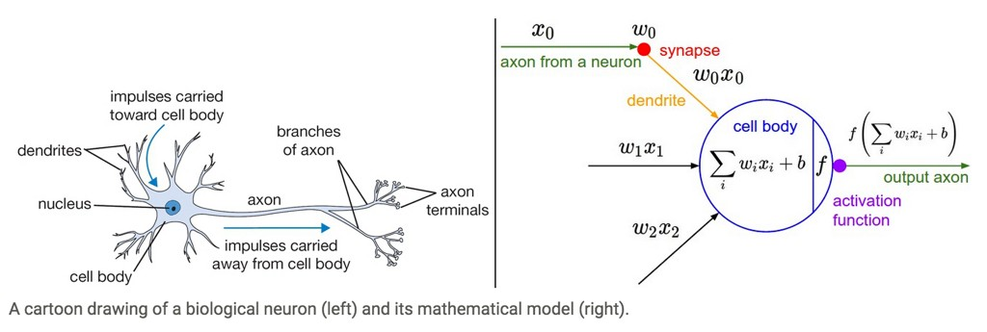
Aside: Inspiration from Biology
Neural nets/perceptrons are loosely inspired by biology.
But they are NOT how the brain works, or even how neurons work.

Slide 5
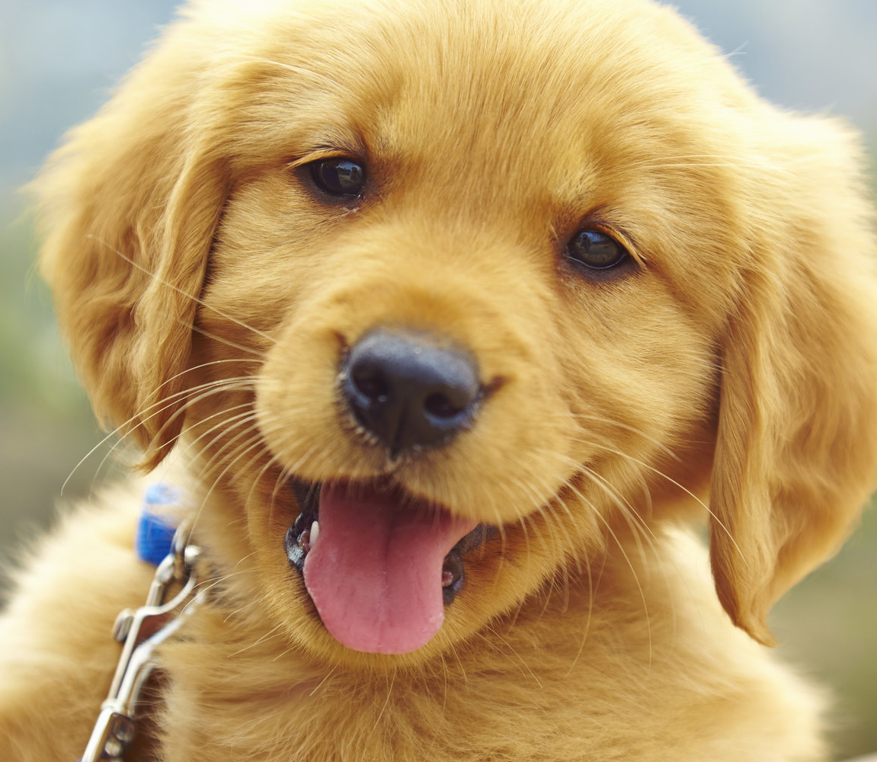
Perceptron: for image classification
weights
sum
sign function
dog

Slide 6
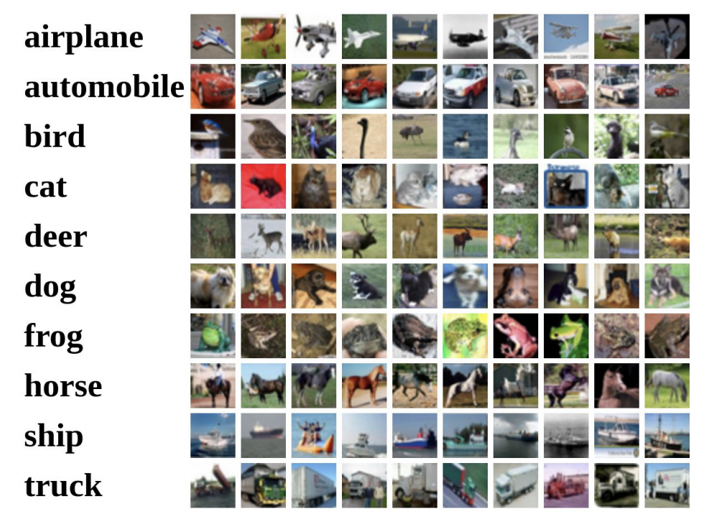
Recall: image classification pipeline
Training Labels
Training Images
Image Features
Training
Learned Classifier
Test Image
Image Features
Learned Classifier
Prediction

Slide 7
Recall: we can featurize images into a vector
Image
Vector
Raw pixels
Raw pixels + (x,y)
PCA
LDA
BoW
BoW + spatial pyramids

Slide 8
Recall: we can featurize images into a vector
Image
Vector
$$\begin{matrix}x_{1} \\ x_{2} \\ \begin{matrix}x_{3} \\ \begin{aligned}… \\ … \\ … \\ … \\ … \\ … \\ … \\ … \\ … \\ \end{aligned} \\ x_{n}\end{matrix}\end{matrix}$$
Raw pixels
Raw pixels + (x,y)
PCA
LDA
BoW
BoW + spatial pyramids

Slide 9
Perceptron: for image classification
weights
sum
sign function
dog

Slide 10
Perceptron: simplified view with one perceptron
dog

Slide 11
Perceptron: simplified view with two perceptrons
cat
dog

Slide 12
Linear classifier as a set of perceptrons
cat
dog
bird

Slide 13
Today's agenda
Perceptron
Linear classifier
Loss function
Gradient descent and backpropagation
Introduction to Convolutional Neural Networks

Slide 14

Linear classifier: input layer
cat
dog
bird
‘input’ layer

Slide 15
Linear classifier: output layer
cat
dog
bird
‘input’ layer
‘output’ layer

Slide 16
Linear classifier: mathematical formulation
$$f(x, W)$$
10 numbers giving class scores
$$W$$
Weights or
Parameters

Slide 17
Linear classifier: mathematical formulation
$$f\left(x, W\right)=Wx$$
$$x=3072×1$$
$$W=?$$
$$f(x, W)$$
10 numbers giving class scores
(32x32x3)
3072 dimensional vector
$$W$$
Weights or
Parameters

Slide 18
Linear classifier: mathematical formulation
$$f\left(x, W\right)=Wx$$
$$x=3072×1$$
$$W=10×3072$$
$$f(x, W)$$
10 numbers giving class scores
(32x32x3)
3072 dimensional vector
$$W$$
Weights or
Parameters

Slide 19
Linear classifier: function visualized
Image
Vector
“score” of the image being an dog
dog Weight Vector
$$×$$
=

Slide 20
Linear classifier: function visualized
Image
Vector
“score” of the image being an cat
cat Weight Vector
$$×$$
=

Slide 21
Linear classifier: function visualized
Image
Vector
“probability” of the image being a bird
$$×$$
=
bird Weight Vector

Slide 22
Linear classifier: function visualized
Truck Weight Vector
Image
Vector
“score” of the image being a truck
$$×$$
=

Slide 23
Linear classifier: function visualized
Weight Matrix
Image
Vector
X
=

Slide 24
Linear classifier: bias vector
Weight Matrix
Image
Vector
Bias
Vector
X
+
=

Slide 25
Linear classifier: size
10x3072
3072x1
10x1
Weight Matrix
Image
Vector
Bias
Vector
X
+
=

Slide 26
Linear classifier: Making a classification
234
94
-104
22
1
$$argmax$$
dog
27.3
-13
-123
99
-82

Slide 27
Interpreting the weights
Assume our weights are trained on the CIFAR 10 dataset with raw pixels:

Slide 28
Interpreting the weights as templates
Let us look at each row of the weight matrix
1x3072
Dog
Cat
Bird
Airplace
Automobile
Deer
Frog
Horse
Ship
truck

Slide 29
Interpreting the weights as templates
We can reshape the vector back in to the shape of an image
1x3072
32x32x3
Dog
Cat
Bird
Airplace
Automobile
Deer
Frog
Horse
Ship
truck

Slide 30
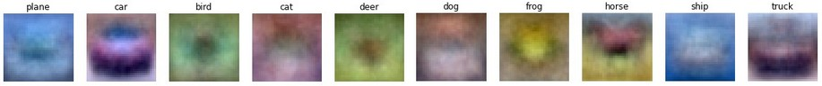
Let's visualize what the templates look like
We can reshape the row back to the shape of an image
Dog
Cat
Bird
Airplace
Automobile
Deer
Frog
Horse
Ship
truck

Slide 31
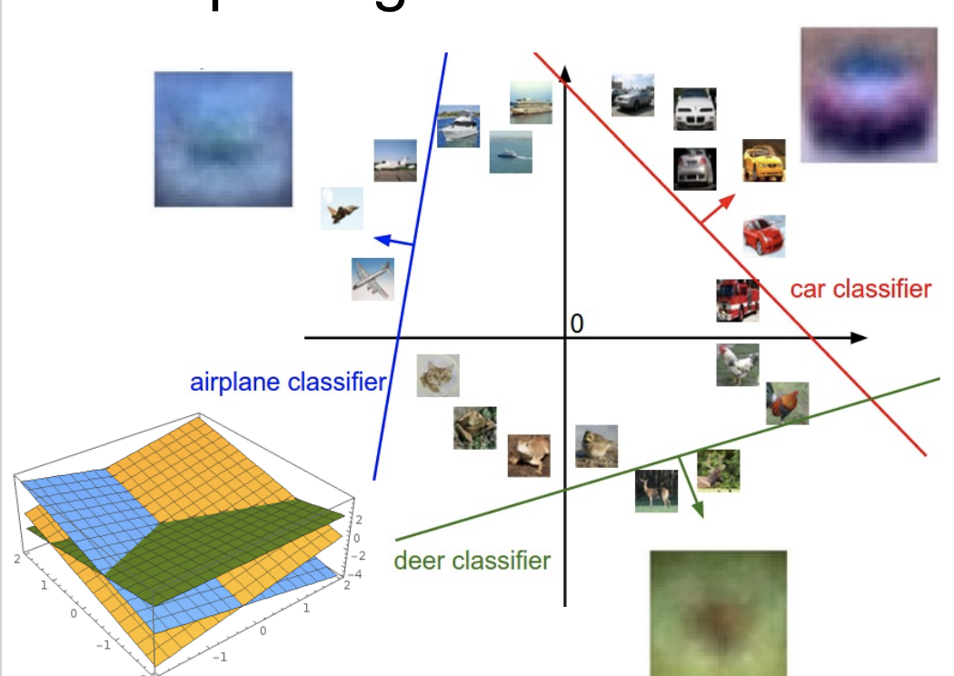
Interpreting the weights geometrically
Assume the image vectors are in 2D space to make it easier to visualize.
Plot created using Wolfram Cloud

Slide 32
Today's agenda
Perceptron
Linear classifier
Loss function
Gradient descent and backpropagation
Neural networks

Slide 33
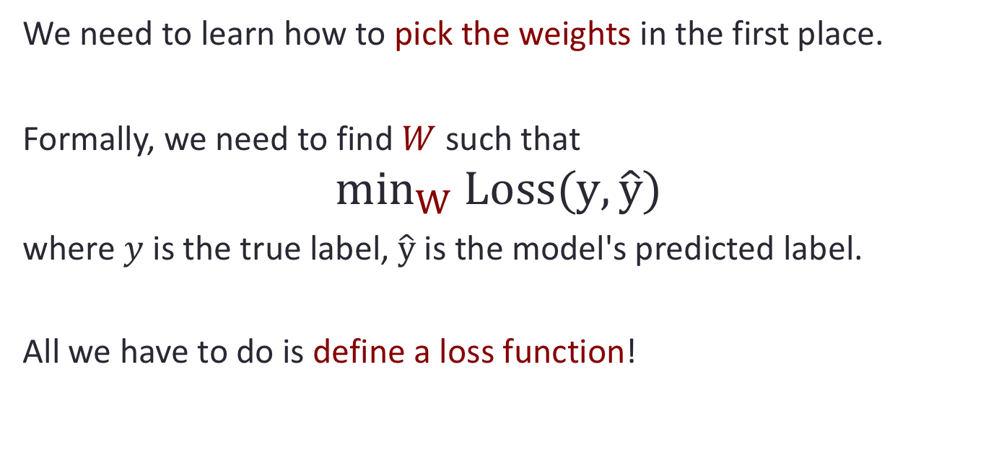
Training linear classifiers
We need to learn how to pick the weights in the first place.
Formally, we need to find $W$ such that
$$\min_{W} Loss(y, \hat{y})$$
where $y$ is the true label, $\hat{y}$ is the model's predicted label.
All we have to do is define a loss function!

Slide 34
Given training data:
W
X
Y
10
10.1
[ 1 0 0 0.1]
10 2 3.5 1
10.1
2
1.9
[ 0 1 0 -0.1]
=
1.9
[ 0 0 1 -0.1]
3.4
3.5
3.4
[ 0.1 0 0 1]
1.1
1
1.1
What do you think is a good approximation weight parameter for this data point?

Slide 35
Given training data:
10
10.1
2
20.1
2
1.9
4
13.1
3.5
3.4
5
2.4
1
1.1
0.6
0.1
What about this one?

Slide 36
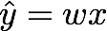
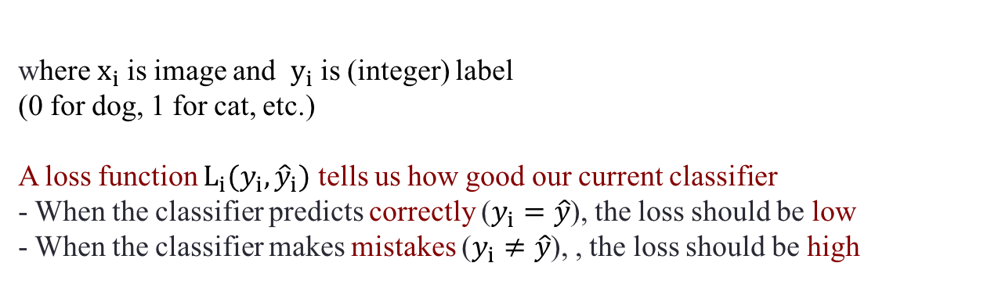
Properties of a loss function
Given several training examples:
and a perceptron:
where $x_{i}$is image and $y_{i}$is (integer) label
(0 for dog, 1 for cat, etc.)
A loss function $L_{i}({y_{i},\hat{y}}_{i})$ tells us how good our current classifier
- When the classifier predicts correctly ($y_{i}=\hat{y}$), the loss should be low
- When the classifier makes mistakes ($y_{i}≠\hat{y}$), , the loss should be high
Notes:
\{ (x_1,y_1), (x_2,y_2), \ldots, (x_N,y_N) \}

Slide 37
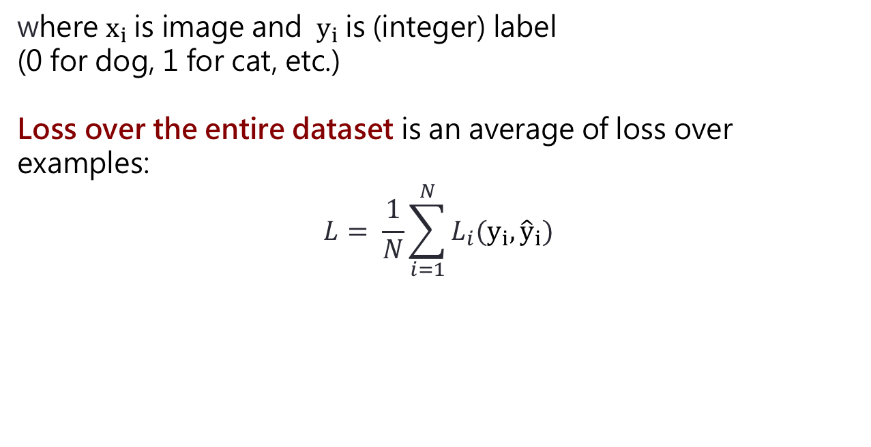
Properties of a loss function
Given several training examples:
and a perceptron:
where $x_{i}$is image and $y_{i}$is (integer) label
(0 for dog, 1 for cat, etc.)
Loss over the entire dataset is an average of loss over examples:
$$L= \frac{1}{N}\sum_{i=1}^{N}{L_{i}(y_{i},{\hat{y}}_{i})}$$
Notes:
\{ (x_1,y_1), (x_2,y_2), \ldots, (x_N,y_N) \}

Slide 38
How do we choose $L_{i}$ ?
YOU get to chose the loss function!
(some are better than others depending on what you want to do)
Notes:
\{ (x_1,y_1), (x_2,y_2), \ldots, (x_N,y_N) \}

Slide 39
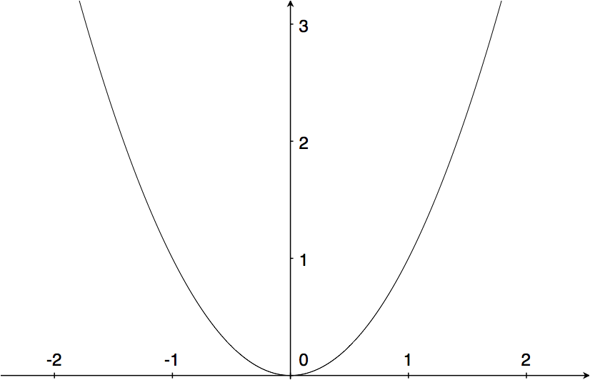
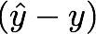
Squared Error (L2)
(a popular loss function)
$L_{i}({y_{i},\hat{y}}_{i})$ = ${(y_{i}− \hat{y}}_{i})^{2}$
Not robust to outliers

Slide 40
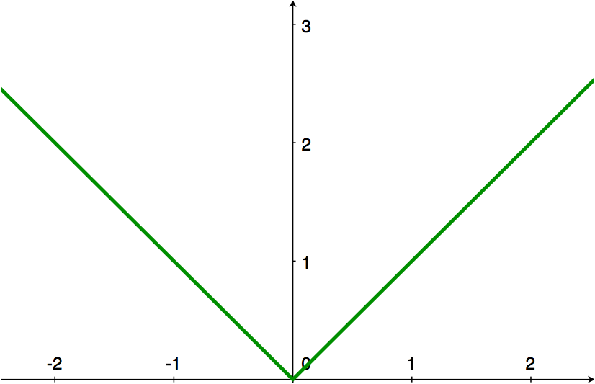
L1 loss
$L_{i}({y_{i},\hat{y}}_{i})$ = ${|y_{i}− \hat{y}}_{i}|$

Slide 41
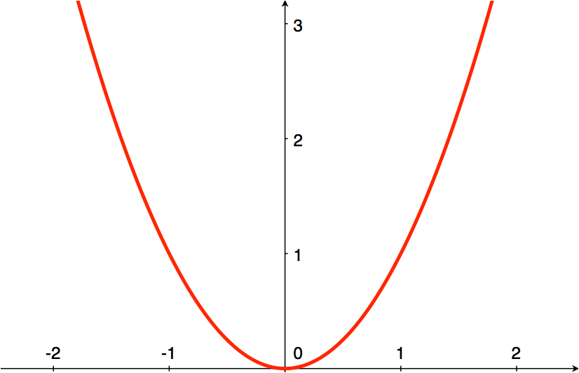
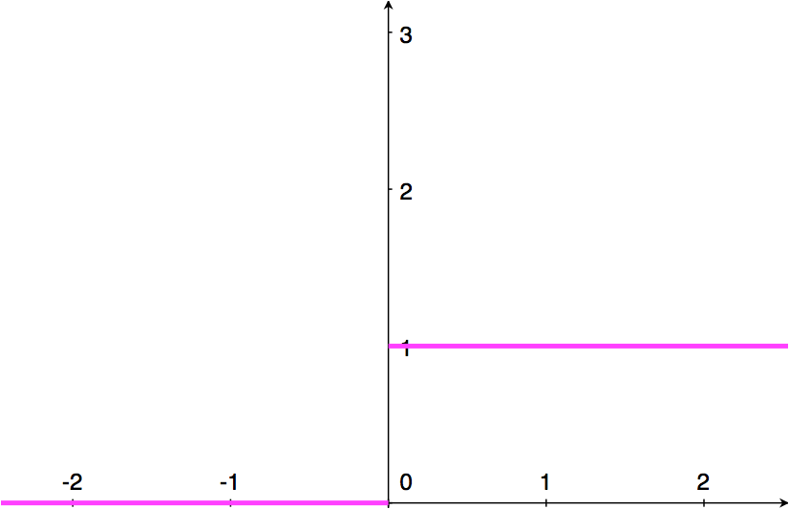
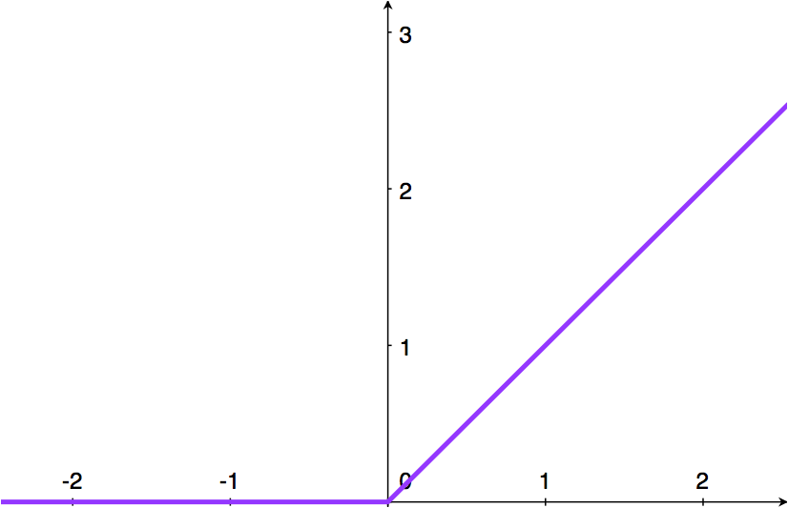
L1 Loss
L2 Loss
$L_{i}({y_{i},\hat{y}}_{i})$ = ${|y_{i}− \hat{y}}_{i}|$
$L_{i}({y_{i},\hat{y}}_{i})$ = ${(y_{i}− \hat{y}}_{i})^{2}$
Zero-One Loss
Hinge Loss
$L_{i}({y_{i},\hat{y}}_{i})$ = ${1||y_{i}≠ \hat{y}}_{i}||$
$L_{i}({y_{i},\hat{y}}_{i})$ = ${max(0, 1−y_{i} \hat{y}}_{i})$

Slide 42
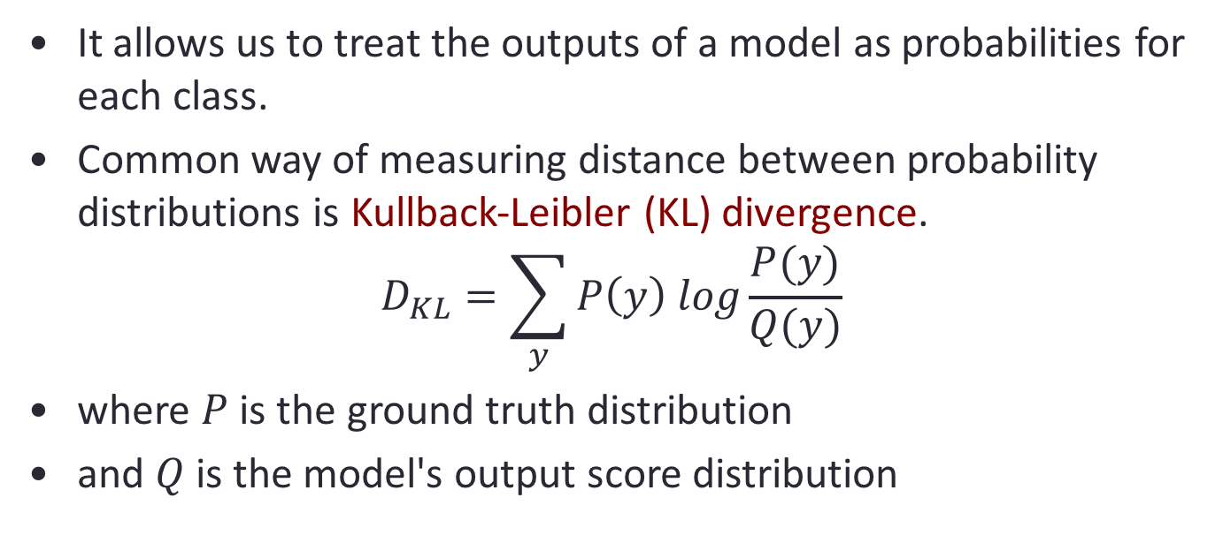
Softmax Classifier (Multinomial Logistic Regression)
It allows us to treat the outputs of a model as probabilities for each class.
Common way of measuring distance between probability distributions is Kullback-Leibler (KL) divergence.
$$D_{KL}=\sum_{y}{P\left(y\right) log\frac{P(y)}{Q(y)}}$$
where $P$ is the ground truth distribution
and $Q$ is the model's output score distribution
Notes:
BENEFIT of using probabilities: allows us to encode uncertainty in the other classes labels into the loss function.

Slide 43
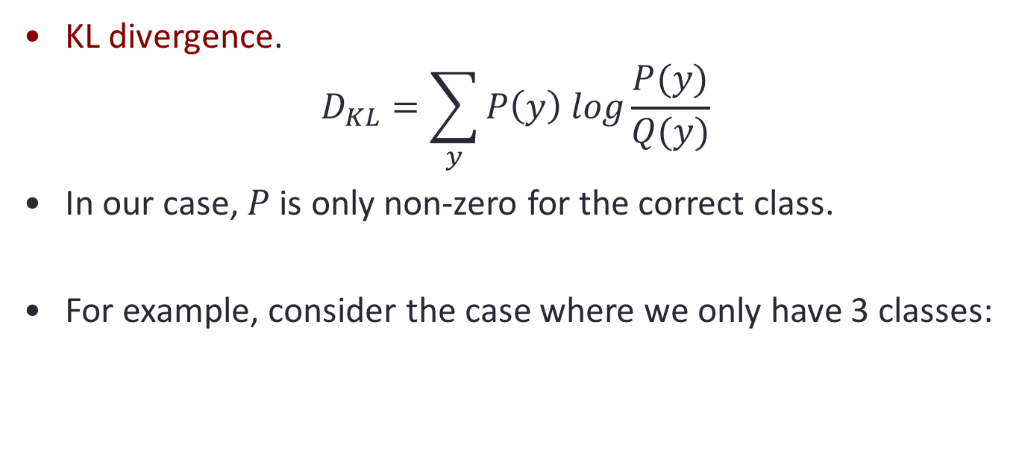
Softmax Classifier (Multinomial Logistic Regression)
KL divergence.
$$D_{KL}=\sum_{y}{P\left(y\right) log\frac{P(y)}{Q(y)}}$$
In our case, $P$ is only non-zero for the correct class.
For example, consider the case where we only have 3 classes:
$$\left[\begin{matrix}1 \\ 0 \\ 0\end{matrix}\right]$$
dog
cat
bird
correct outputs

Slide 44
Softmax Classifier (Multinomial Logistic Regression)
KL divergence.
$$D_{KL}=\sum_{y}{P\left(y\right) log\frac{P(y)}{Q(y)}}$$
$=−\log{Q\left(y\right)}$ when $y = dog$
$$=−\log{Prob[f\left(x_{i},W\right)=y_{i}]}$$
$$\left[\begin{matrix}1 \\ 0 \\ 0\end{matrix}\right]$$
dog
cat
bird
correct outputs

Slide 45
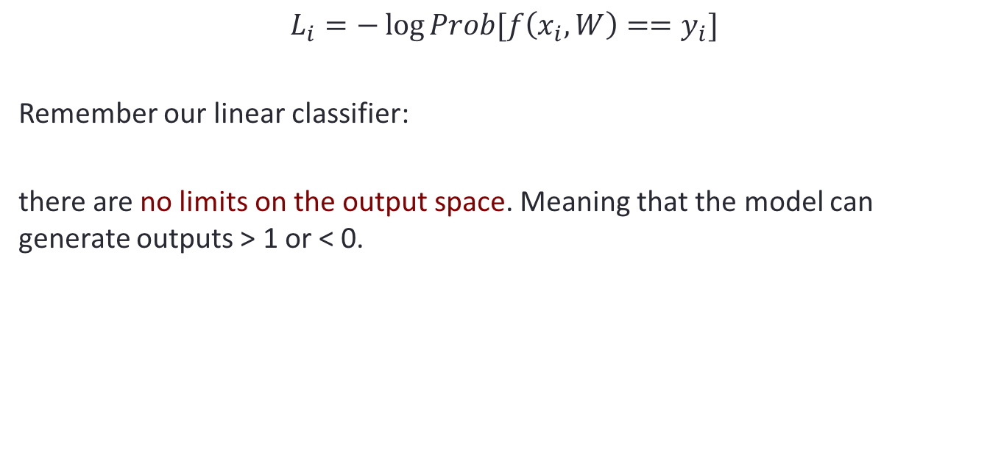
Softmax Classifier (Multinomial Logistic Regression)
$$L_{i}=−\log{Prob[f\left(x_{i},W\right)==y_{i}]}$$
Remember our linear classifier:
there are no limits on the output space. Meaning that the model can generate outputs > 1 or < 0.
$$\left[\begin{matrix}3.2 \\ 5.1 \\ −1.7\end{matrix}\right]$$
$$\left[\begin{matrix}1 \\ 0 \\ 0\end{matrix}\right]$$
dog
cat
bird
model outputs
correct outputs

Slide 46
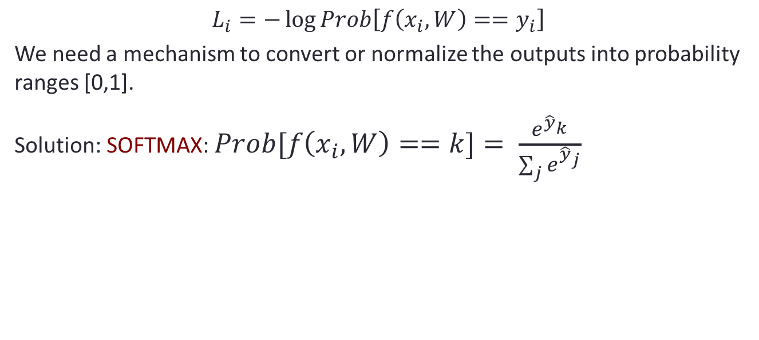
Softmax Classifier (Multinomial Logistic Regression)
$$L_{i}=−\log{Prob\left[f\left(x_{i},W\right)==y_{i}\right]}$$
We need a mechanism to convert or normalize the outputs into probability ranges [0,1].
Solution: SOFTMAX: $Prob[f\left(x_{i},W\right)==k]= \frac{e^{{\hat{y}}_{k}}}{\sum_{j}{e^{{\hat{y}}_{j}}}}$
$$\left[\begin{matrix}3.2 \\ 5.1 \\ −1.7\end{matrix}\right]$$
$$\left[\begin{matrix}1 \\ 0 \\ 0\end{matrix}\right]$$
dog
cat
bird
model outputs
correct outputs

Slide 47
Softmax Classifier (Multinomial Logistic Regression)
$$L_{i}=−\log{Prob\left[f\left(x_{i},W\right)==y_{i}\right]}$$
We need a mechanism to convert or normalize the outputs into probability ranges [0,1].
Solution: SOFTMAX: $Prob[f\left(x_{i},W\right)==k]= \frac{e^{{\hat{y}}_{k}}}{\sum_{j}{e^{{\hat{y}}_{j}}}}$
$$\left[\begin{matrix}3.2 \\ 5.1 \\ −1.7\end{matrix}\right]$$
$$\left[\begin{matrix}24.5 \\ 164 \\ 0.18\end{matrix}\right]$$
$$\left[\begin{matrix}0.13 \\ 0.87 \\ 0.00\end{matrix}\right]$$
$$\left[\begin{matrix}1 \\ 0 \\ 0\end{matrix}\right]$$
dog
cat
bird
exp
norm
loss
model outputs
probabilities
correct outputs

Slide 48
Softmax Classifier (Multinomial Logistic Regression)
$$L_{i}=−\log{Prob\left[f\left(x_{i},W\right)==y_{i}\right]}$$
In this case, what is the loss:
$$L_{i}=??$$
$$\left[\begin{matrix}3.2 \\ 5.1 \\ −1.7\end{matrix}\right]$$
$$\left[\begin{matrix}24.5 \\ 164 \\ 0.18\end{matrix}\right]$$
$$\left[\begin{matrix}0.13 \\ 0.87 \\ 0.00\end{matrix}\right]$$
$$\left[\begin{matrix}1 \\ 0 \\ 0\end{matrix}\right]$$
dog
cat
bird
exp
norm
loss
model outputs
probabilities
correct outputs

Slide 49
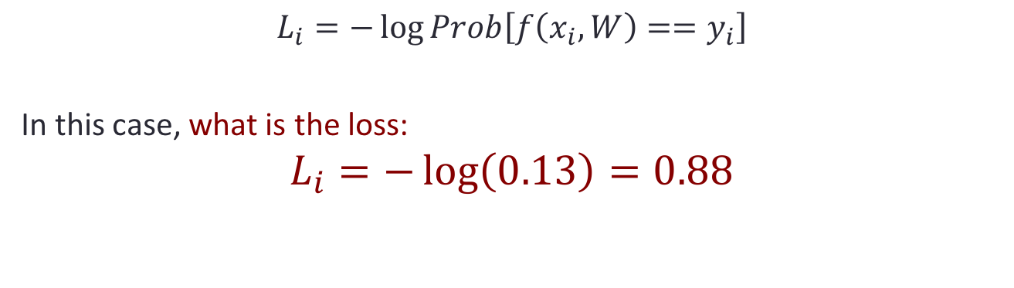
Softmax Classifier (Multinomial Logistic Regression)
$$L_{i}=−\log{Prob\left[f\left(x_{i},W\right)==y_{i}\right]}$$
In this case, what is the loss:
$$L_{i}=−\log\left(0.13\right)=0.88$$
$$\left[\begin{matrix}3.2 \\ 5.1 \\ −1.7\end{matrix}\right]$$
$$\left[\begin{matrix}24.5 \\ 164 \\ 0.18\end{matrix}\right]$$
$$\left[\begin{matrix}0.13 \\ 0.87 \\ 0.00\end{matrix}\right]$$
$$\left[\begin{matrix}1 \\ 0 \\ 0\end{matrix}\right]$$
dog
cat
bird
exp
norm
loss
model outputs
probabilities
correct outputs

Slide 50
Softmax Classifier (Multinomial Logistic Regression)
$$L_{i}=−\log{Prob\left[f\left(x_{i},W\right)==y_{i}\right]}$$
What is the minimum and maximum values that the loss can be?
$$\left[\begin{matrix}3.2 \\ 5.1 \\ −1.7\end{matrix}\right]$$
$$\left[\begin{matrix}24.5 \\ 164 \\ 0.18\end{matrix}\right]$$
$$\left[\begin{matrix}0.13 \\ 0.87 \\ 0.00\end{matrix}\right]$$
$$\left[\begin{matrix}1 \\ 0 \\ 0\end{matrix}\right]$$
dog
cat
bird
exp
norm
loss
model outputs
probabilities
correct outputs
Notes:
Min/max = 0, infinity

Slide 51
Softmax Classifier (Multinomial Logistic Regression)
$$L_{i}=−\log{Prob\left[f\left(x_{i},W\right)==y_{i}\right]}$$
At initialization, all the weights will be random. In this case, we can assume that the outputs will have the same probability. In this case, what will the initial loss be?
$$\left[\begin{matrix}3.2 \\ 5.1 \\ −1.7\end{matrix}\right]$$
$$\left[\begin{matrix}24.5 \\ 164 \\ 0.18\end{matrix}\right]$$
$$\left[\begin{matrix}0.13 \\ 0.87 \\ 0.00\end{matrix}\right]$$
$$\left[\begin{matrix}1 \\ 0 \\ 0\end{matrix}\right]$$
dog
cat
bird
exp
norm
loss
model outputs
probabilities
correct outputs
Notes:
Min/max = 0, infinity

Slide 52
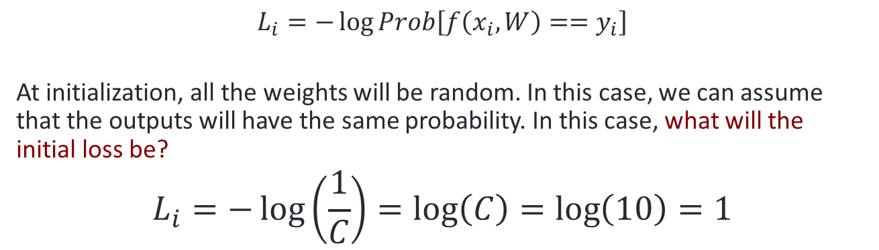
Softmax Classifier (Multinomial Logistic Regression)
$$L_{i}=−\log{Prob\left[f\left(x_{i},W\right)==y_{i}\right]}$$
At initialization, all the weights will be random. In this case, we can assume that the outputs will have the same probability. In this case, what will the initial loss be?
$$L_{i}=−\log\left(\frac{1}{C}\right)=\log\left(C\right)=\log\left(10\right)=1$$
$$\left[\begin{matrix}3.2 \\ 5.1 \\ −1.7\end{matrix}\right]$$
$$\left[\begin{matrix}24.5 \\ 164 \\ 0.18\end{matrix}\right]$$
$$\left[\begin{matrix}0.13 \\ 0.87 \\ 0.00\end{matrix}\right]$$
$$\left[\begin{matrix}1 \\ 0 \\ 0\end{matrix}\right]$$
dog
cat
bird
exp
norm
loss
model outputs
probabilities
correct outputs
Notes:
Min/max = 0, infinity

Slide 53
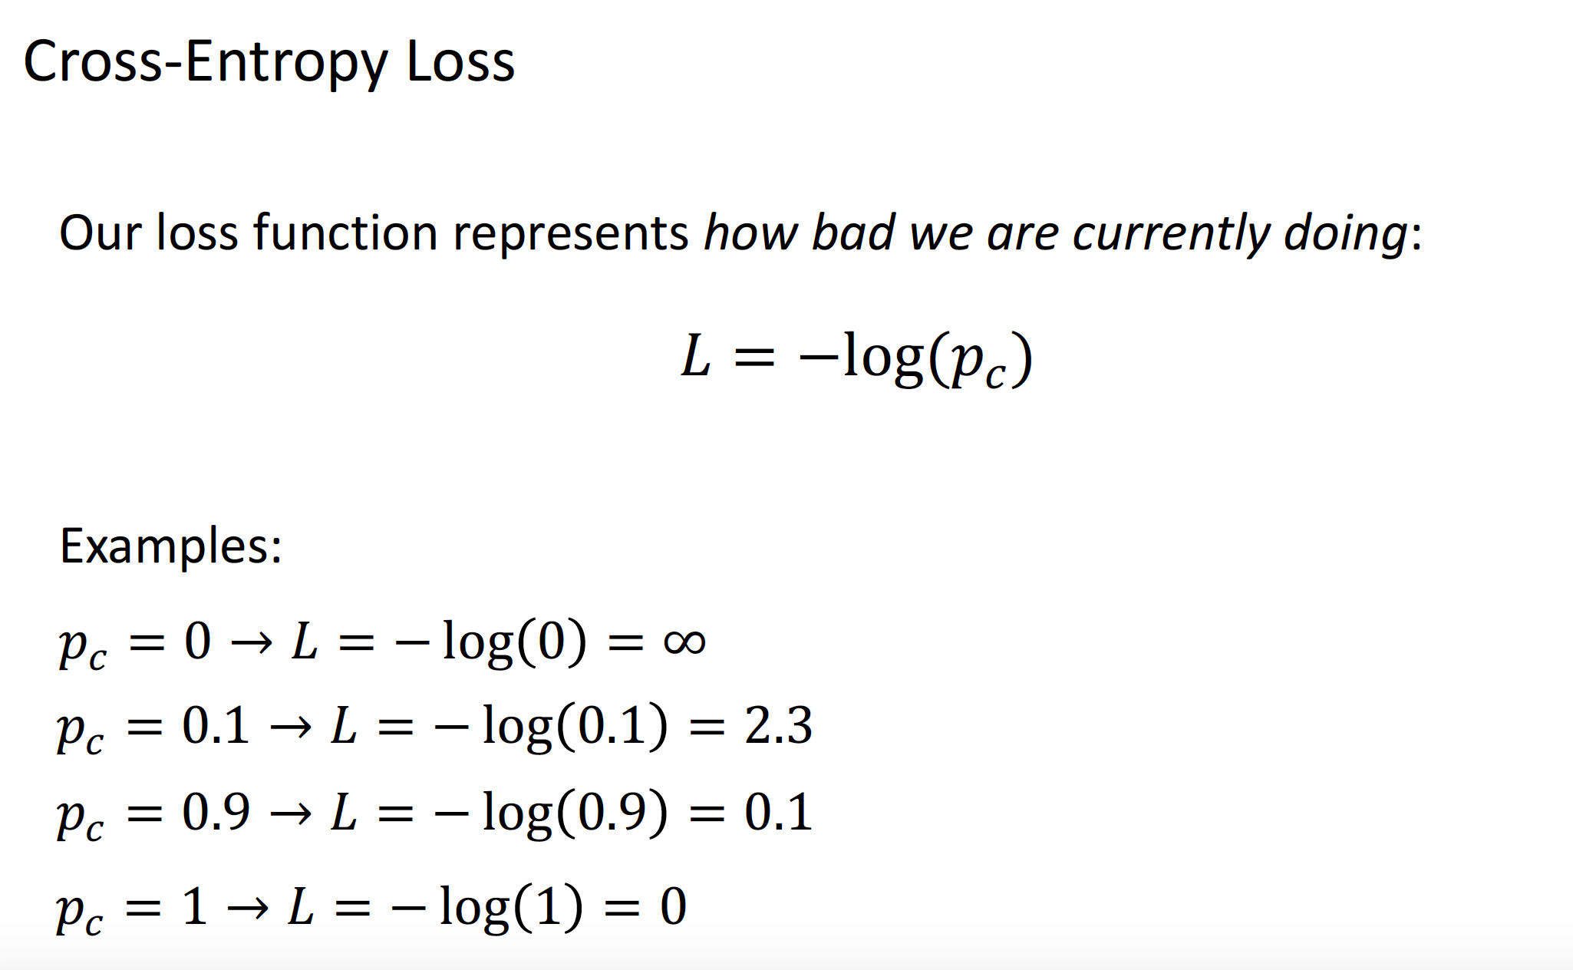

Slide 54
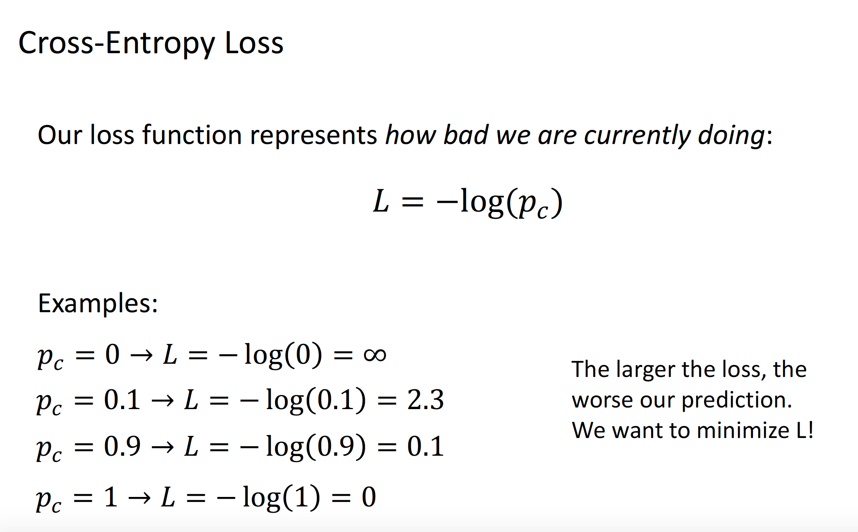

Slide 55
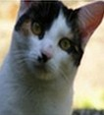
Softmax Classifier (Multinomial Logistic Regression)
cat
3.2
car
5.1
-1.7
frog
Notes:
Softmax classifier (aka Multinomial LR) is the second most common multiclass linear classifier. Generalization of logistic regression, if you're familiar with that.

Slide 56
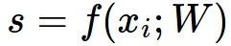
Softmax Classifier (Multinomial Logistic Regression)
scores = unnormalized log probabilities of the classes.
cat
3.2
car
5.1
-1.7
frog
Notes:
Basically a different functional form of the loss function. We'll interpret these scores as "unnormalized log probabilities". We'll convert them into probabilities by a trick: First exponentiate to get "unnormalized class probs", and then normalize them to get "normalized class probs".

Slide 57
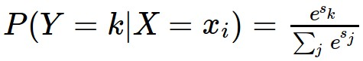
Softmax Classifier (Multinomial Logistic Regression)
scores = unnormalized log probabilities of the classes.
where
cat
3.2
car
5.1
-1.7
frog
Notes:
This basically mapping "unnormalized lgo probs" back to "normalzied probs"

Slide 58
Softmax Classifier (Multinomial Logistic Regression)
scores = unnormalized log probabilities of the classes.
where
cat
3.2
Softmax function
car
5.1
-1.7
frog
Notes:
This particular function is called softmax. This is the class probability, then in the probabilistic world what we want is quite clear: maximize the probaility of the correct class, that is "Maximize the likelihood".

Slide 59
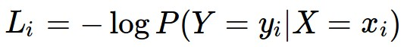
Softmax Classifier (Multinomial Logistic Regression)
scores = unnormalized log probabilities of the classes.
Want to maximize the log likelihood, or (for a loss function)
to minimize the negative log likelihood of the correct class:
where
cat
3.2
car
5.1
-1.7
frog
Notes:
MLE is equivalent to minimizing the negative log-likelihood

Slide 60
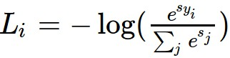
Softmax Classifier (Multinomial Logistic Regression)
scores = unnormalized log probabilities of the classes.
Want to maximize the log likelihood, or (for a loss function)
to minimize the negative log likelihood of the correct class:
where
cat
3.2
car
5.1
-1.7
frog
in summary:
Notes:
This is the loss function per example

Slide 61
Softmax Classifier (Multinomial Logistic Regression)
cat
3.2
car
5.1
-1.7
frog
unnormalized log probabilities
Notes:
Let's look at a particular example...

Slide 62
Softmax Classifier (Multinomial Logistic Regression)
unnormalized probabilities
cat
3.2
24.5
exp
car
5.1
164.0
-1.7
0.18
frog
unnormalized log probabilities

Slide 63
Softmax Classifier (Multinomial Logistic Regression)
unnormalized probabilities
cat
3.2
24.5
0.13
exp
normalize
car
5.1
164.0
0.87
-1.7
0.18
0.00
frog
unnormalized log probabilities
probabilities
Notes:
Probability assign to this image being a cat is 0.13, and so on..

Slide 64
Softmax Classifier (Multinomial Logistic Regression)
unnormalized probabilities
cat
3.2
24.5
0.13
L_i = -log(0.13)
= 0.89
exp
normalize
car
5.1
164.0
0.87
-1.7
0.18
0.00
frog
unnormalized log probabilities
probabilities

Slide 65
Today's agenda
Perceptron
Linear classifier
Loss function
Gradient descent and backpropagation
Introduction to Convolutional Neural networks

Slide 66
Gradient descent visualized: Minimizing loss
$$L$$
$$w$$

Slide 67
Gradient descent visualized: Minimizing loss
$$L$$
$$w$$

Slide 68
Gradient descent visualized: Minimizing loss
$$L$$
$$w$$

Slide 69
Gradient descent visualized: Minimizing loss
$$L$$
$$w$$

Slide 70
Gradient descent visualized: Minimizing loss
$$L$$
$$w$$

Slide 71
Gradient descent visualized: Minimizing loss
$$L$$
$$w$$

Slide 72
Gradient descent visualized: Minimizing loss
$$L$$
$$w$$

Slide 73
Gradient descent visualized: Minimizing loss
$$L$$
$$w$$

Slide 74
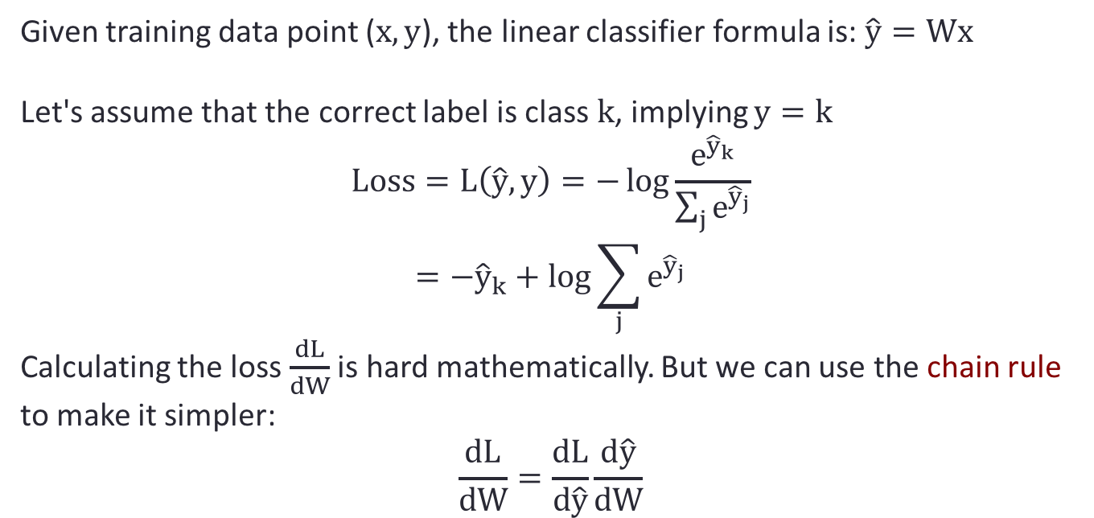
Partial derivative of loss to update weights
Given training data point ($x,y$), the linear classifier formula is: $\hat{y}=Wx$
Let's assume that the correct label is class $k$, implying $y=k$
$$Loss=L\left(\hat{y}, y\right)=−\log{\frac{e^{{\hat{y}}_{k}}}{\sum_{j}{e^{{\hat{y}}_{j}}}}}$$
$$=−{\hat{y}}_{k}+log⁡\sum_{j}{e^{{\hat{y}}_{j}}}$$
Calculating the loss $\frac{dL}{dW}$ is hard mathematically. But we can use the chain rule to make it simpler:
$$\frac{dL}{dW}=\frac{dL}{d\hat{y}}\frac{d\hat{y}}{dW}$$

Slide 75
Backprop – another way of computing gradients
$$\hat{y}=Wx$$
$$L=Loss\left(\hat{y}, y\right)$$
$$\frac{dL}{dW}=\frac{dL}{d\hat{y}}\frac{d\hat{y}}{dW}$$
$$W$$
$$\hat{y}$$
$$\frac{dL }{dW}$$
$$×$$
$$Loss$$
$$\frac{dL}{d\hat{y} }$$
$$x$$
$$y$$
Key Insight:
visualize the computation as a graph
Compute the forward pass to calculate the loss.
Compute all gradients for each computation backwards

Slide 76
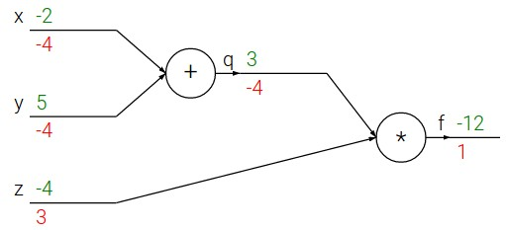
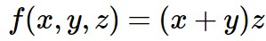
e.g. x = -2, y = 5, z = -4
Notes:
Here is a very small computational graph corresponding to the function … We have example inputs...

Slide 77
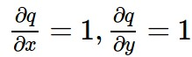
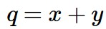
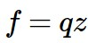
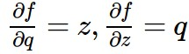
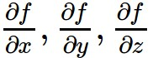
e.g. x = -2, y = 5, z = -4
Want:
Notes:
Define q, f. We see the intermediate partial derivatives. To compute the value of f() wrt. To the inputs -2, … , we'll perform a forward pass. (Go over q and f steps.). To compute the partial derivatives df/dx, … we'll do a "backward pass", we start from the output and progressively move towards the input (back to front).

Slide 78
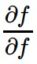
e.g. x = -2, y = 5, z = -4
Want:
Notes:
The base case is the ID function. What's the gradient?
Write the gradients (aka the backward signal) on the bottom of the arrows.

Slide 79
e.g. x = -2, y = 5, z = -4
Want:
Notes:
Gradient on z is 3 → increasing z by h, increases f by 3h. That is, f reacts positively on changes in z.

Slide 80
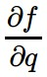
e.g. x = -2, y = 5, z = -4
Want:

Slide 81
e.g. x = -2, y = 5, z = -4
Want:
Notes:
If q were to increase, the f will decrease

Slide 82
e.g. x = -2, y = 5, z = -4
Want:
Notes:
HOw do you compute this? You can use Calculus 101 -- there are many ways to do this , but the way I'd like to do is by chain rule.

Slide 83
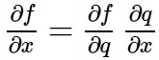
e.g. x = -2, y = 5, z = -4
Chain rule:
Want:
Notes:
Chain rule says that df/dx is equivalent to …
df/dq is the local influence of q on f, and similar for dfq/dx.
Chain rule says we should chain these two things, these two local gradients to find the global influence of y on f: -4 * 1
Talk a bit more about this.
Increasing y by h globally decreases f by 4h.
This is very crucial to understand: we will recursively chain local gradients to obtain global gradients, and this is basically what backprop is all about: avoids dealing with complicated symbolic computations. Instead, we deal only with simple, local gradients, and then use them from output back to input.

Slide 84
e.g. x = -2, y = 5, z = -4
Want:
Notes:
Similar for df/dx

Slide 85
e.g. x = -2, y = 5, z = -4
Chain rule:
Want:
Notes:
We know x's influence on q, and q's influence on f.

Slide 86
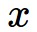
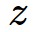
activations
f
Notes:
We can generalize it as follows. You are a node in the circuit. You receive some input, you do some operations and give z. You don't know what's happening but at the end of forward pass you get the final output (eg, loss).

Slide 87
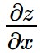
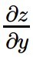
activations
f
“local gradient”
Notes:
In the back-ward pass, you tell me what's the influence of my output on the final loss. I know the influence of my inputs on my output. By chaining these knowledge, I can tell the influence of my input, on the final loss.

Slide 88
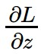
activations
f
“local gradient”
gradients

Slide 89
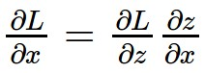
activations
f
“local gradient”
gradients

Slide 90
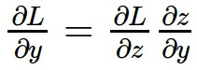
activations
f
“local gradient”
gradients

Slide 91
activations
another node OR local parameter
f
“local gradient”
gradients
another node OR local parameter
Notes:
Note: x can a parameter, or really an input from another gate. In training, you need both of them: I need to send the signal back to the input. I also need to compute the gradient wrt. Model parameters. We don't really need to mak any separation between the parameters and intermediate values.

Slide 92
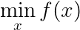
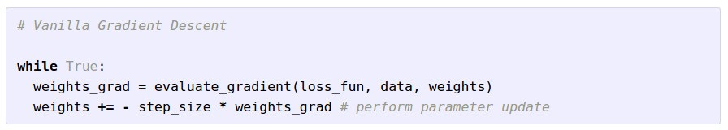
Gradient Descent
Notes:
Now we want to find the x such that it miniimizes f(x). Gradient tells us the direction with maximum increase.
Step_size is the same as learning rate. A headache to choose (together with regularization weight.)

Slide 93
Loss is a function of the model’s parameters

Slide 94
How to minimize loss?
Start at random point

Slide 95
How to minimize loss?
Compute:

Slide 96
How to minimize loss?
Move in direction opposite of gradient to new point

Slide 97
How to minimize loss?
Move in direction opposite of gradient to new point

Slide 98
How to minimize loss?
Repeat!

Slide 99
This is called Stochastic Gradient Descent (SGD)
Repeat!

Slide 100
Stochastic Gradient Descent (SGD)
Initialize θ randomly
For N Epochs
For each training example (x, y):
Compute Loss Gradient:
Update θ with update rule:

Slide 101
Why is it Stochastic Gradient Descent?
Initialize θ randomly
For N Epochs
For each training example (x, y):
Compute Loss Gradient:
Update θ with update rule:
Only an estimate of true gradient!

Slide 102
Why is it Stochastic Gradient Descent?
Initialize θ randomly
For N Epochs
For each training batch {(x₀, y₀),…, (x_{B}, y_{B})}:
Compute Loss Gradient:
Update θ with update rule:
More accurate estimate!
Advantages:
More accurate estimation of gradient
Smoother convergence
Allows for larger learning rates
Minibatches lead to fast training!
Can parallelize computation + achieve significant speed increases on GPU’s

Slide 103
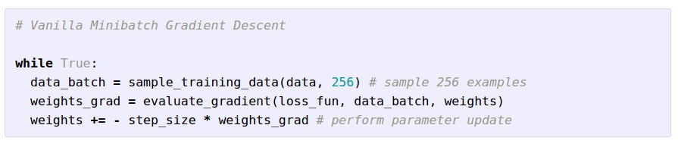
Mini-batch Gradient Descent
only use a small portion of the training set to compute the gradient.
Common mini-batch sizes are 32/64/128 examples
e.g. Krizhevsky ILSVRC ConvNet used 256 examples
Notes:
In practice, in deep learning, we train over huge datasets -- executing f(x) and grad[f(x)] is infeasible to run. So, approximate the gradient using a minibatch. Normally, you choose a batch_size that is as large as possible.

Slide 104
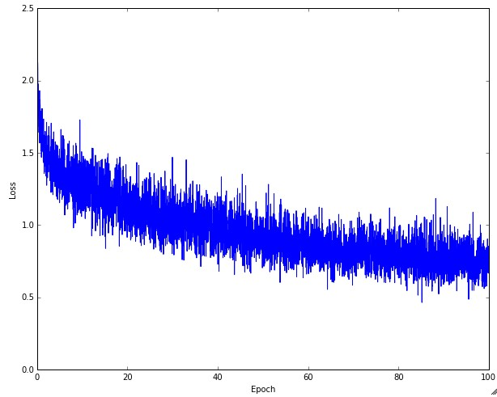
Example of optimization progress while training a neural network.
(Loss over mini-batches goes down over time.)
Notes:
If this was not mini-batch, you'd expect the curve to be much smoother. Our gradient is approximate, so sometimes gradient increases, sometimes it decreases.

Slide 105

The effects of step size (or “learning rate”)
Notes:
The plot of effects of learning rate. Low-learning -> takes forever. Very high learning rate -> explosion of gradients, usually ends in some inf. High-learning rate - get stuck around a local minima, never makes small-enough steps to further reduce the objective value. Most of time you start with a high learning rate and them decay it over time.

Slide 106

The effects of different update form formulas
(image credits to Alec Radford)
Notes:
Different update formulas give you better or worse convergence. SGD works poorly here.

Slide 107
Remember our linear classifier
cat
dog
bird

Slide 108
Let's change the features by adding another layer
$$W_{1}$$
$$W_{2}$$
cat
dog
bird

Slide 109
2-layer network: mathematical formula
linear classifier:
$$y=Wx$$
2-layer network:
$$y=W_{2}\max\left(0,W_{1}x\right)$$
3-layer network:
$$y=W_{3}\max\left(0,W_{2}\max\left(0,W_{1}x\right)\right)$$
Choosing the number of layers is a new hyperparameter!

Slide 110

2-layer network: mathematical formula
linear classifier:
$$y=Wx$$
2-layer network:
$$y=W_{2}\max\left(0,W_{1}x\right)$$
We know the size of $x=1×3072$ and $y=10×1$
So what are $W_{1}$and $W_{2}$
We know that they must be: $W_{1}=h×3072$and $W_{2}=10×h$
h is a new hyperparameter!

Slide 111
2-layer network: mathematical formula
linear classifier:
$$y=Wx$$
2-layer network:
$$y=W_{2}\max\left(0,W_{1}x\right)$$
Why is the max(0, _) necessary? Let's see what happens when we remove it:
$$y=W_{2}W_{1}x=Wx$$
where
$$W=W_{2}W_{1}$$

Slide 112

Activation function
The non-linear max function allows models to learn more complex transformations for features.
Choosing the right activation function is another new hyperparameter!

Slide 113
Today's agenda
Perceptron
Linear classifier
Loss function
Gradient descent and backpropagation
Introduction to Convolutional Neural Networks

Slide 114
Recall: image classification pipeline
Training Labels
Training Images
Image Features
Training
Learned Classifier
Test Image
Image Features
Learned Classifier
Prediction

Slide 115


Recall convolutions…
12 | 3 | 19
25 | 10 | 1
9 | 7 | 17
1 | 2
3 | 4
? | ?
? | ?
*
=

Slide 116
Recall convolutions…
12 | 3 | 19
25 | 10 | 1
9 | 7 | 17
1 | 2
3 | 4
133 | ?
? | ?
*
=

Slide 117
Recall convolutions…
12 | 3 | 19
25 | 10 | 1
9 | 7 | 17
1 | 2
3 | 4
133 | 75
? | ?
*
=

Slide 118
Recall convolutions…
12 | 3 | 19
25 | 10 | 1
9 | 7 | 17
1 | 2
3 | 4
133 | 75
100 | ?
*
=

Slide 119
Recall convolutions…
12 | 3 | 19
25 | 10 | 1
9 | 7 | 17
1 | 2
3 | 4
133 | 75
100 | 101
*
=
Notes:
Equation

Slide 120
Recall convolutions…
12 | 3 | 19
25 | 10 | 1
9 | 7 | 17
1 | 2
3 | 4
133 | 75
100 | 101
*
=
Notes:
Equation

Slide 121
Recall convolutions…
12 | 21
18 | 31
1 | 2
3 | 4
?
*
=
Notes:
Equation

Slide 122
Recall convolutions…
12 | 21
18 | 31
1 | 2
3 | 4
232
*
=
Notes:
Equation

Slide 123


Why they are useful
Allow us to find interesting insights/features from images!
0 | -½ | 0
0 | 0 | 0
0 | ½ | 0
*
=

Slide 124
Recall Image Classification…
Featurizer
Classifier
“pupper”
Allow us to use features to put images in categories!

Slide 125

Wait a Minute…
Convolution = Image -> Features
Classification Algorithm = Features -> Category

Slide 126

Wait a Minute…
Convolution = Image -> Features
Classification Algorithm = Features -> Category
Let’s put ‘em together!

Slide 127

In Specific…
Let’s build a convolution-based classification algorithm for the CIFAR-10 dataset (10 classes, 32x32 images):

Slide 128

Feature Extractor
32x32 “Airplane Filter”
*
=

Slide 129
Feature Extractor
“probability” of the image being an airplane
32x32 “Airplane Filter”
*
=

Slide 130
Feature Extractor
“probability” of the image being an airplane
32x32 “Airplane Filter”
*
=

Slide 131
Feature Extractor
This is not really a probability but a score, because it can be less than 0 and greater than 1
“probability” of the image being an airplane
32x32 “Airplane Filter”
*
=

Slide 132
Feature Extractor
“probability” of the image being an automobile
32x32 “Automobile Filter”
*
=

Slide 133
Feature Extractor
“probability” of the image being a bird
32x32 “Bird Filter”
*
=

Slide 134
Feature Extractor
“probability” of the image being a truck
32x32 “Truck Filter”
*
=

Slide 135


Slide 136



The Whole Matter
32x32x10 Conv Block
Feature Extractor
Prediction
Classifier
Classification Output
Image

Slide 137

The Whole Matter
32x32x10 Conv Block
Feature Extractor
Prediction
Classifier
Classification Output
Image

Slide 138


Slide 139
Reframed Feature Extractor
32x32 “Airplane Filter”
*

Slide 140
Reframed Feature Extractor
Image
Vector
Airplane Weight Vector
32x32 “Airplane Filter”
.
*
=

Slide 141
New Feature Extractor
Image
Vector
Airplane Weight Vector
“probability” of the image being an airplane
.
=

Slide 142
New Feature Extractor
Image
Vector
Automobile Weight Vector
“probability” of the image being an automobile
.
=

Slide 143
New Feature Extractor
Image
Vector
Bird Weight Vector
“probability” of the image being a bird
.
=

Slide 144
New Feature Extractor
Image
Vector
Truck Weight Vector
“probability” of the image being a truck
.
=

Slide 145
New Feature Extractor
Weight Matrix
Image
Vector
X
=

Slide 146


Slide 147


Slide 148


Slide 149


Slide 150


Slide 151


Slide 152


Slide 153


Slide 154
2-layer neural network performance
~40% accuracy on CIFAR-10 test
Best class: Truck (~60%)
Worst class: Horse (~16%)
Check out the model at: https://tinyurl.com/cifar10

Slide 155


